Slide 1
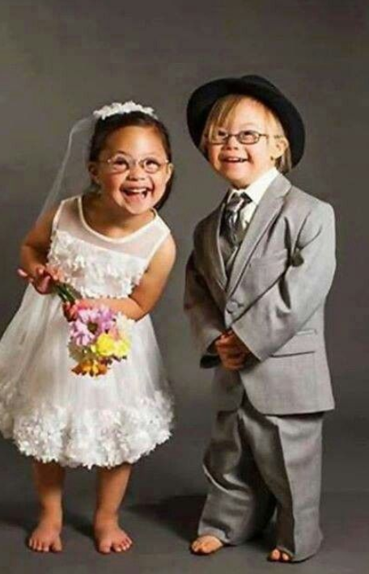
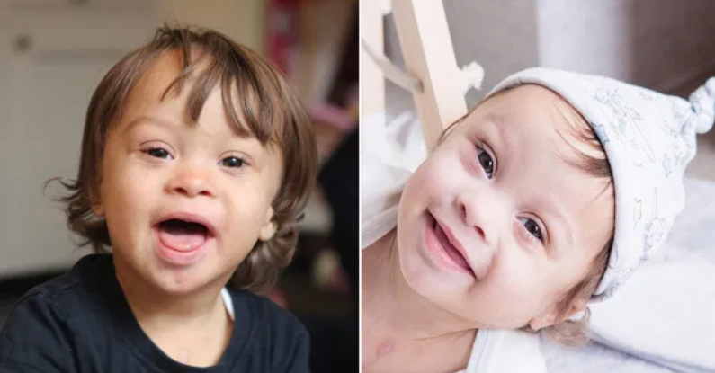
Beauty Of Down syndrome
Mala L,
Arati,
Komal,
Jinendar.

Slide 2
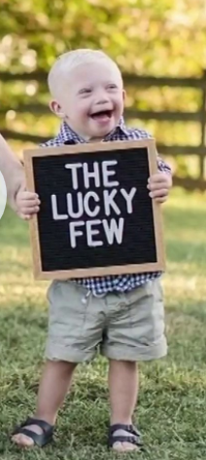
Oh! I am a Child with Down’s
I own so many feathers on my Crown
I am full of Love and Care
I make my surroundings happy and lovable
I can do anything if I dare
My multi-talents has been shown, most of them you have already known
Time which you spend with me becomes memorable
Focus more on my Ability & less on disability
I am the source of unconditional Love

Slide 3
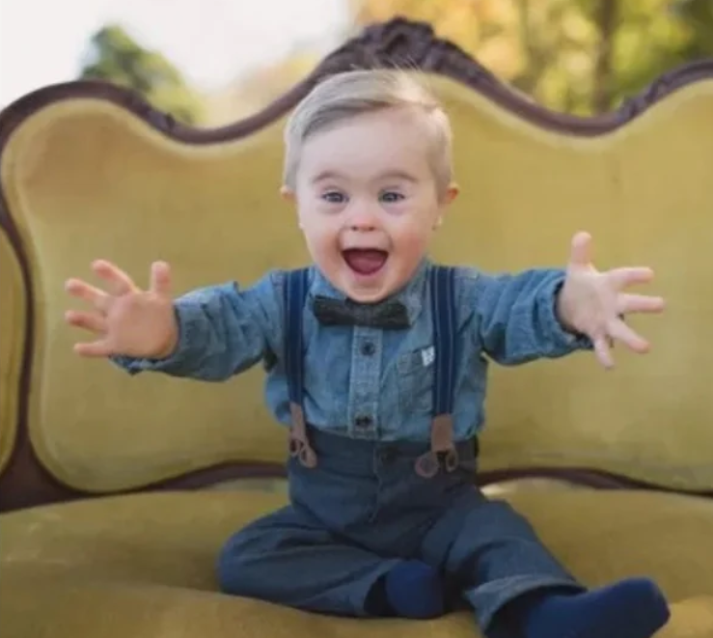
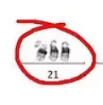
My mom says I am precious child of my parents, but the world says I have extra chromosome. So what, I am not less than others. my extra chromosome make me more cute, happy, lovable, caring, and joyful

Slide 4
We are Gifted with lot of skills, talents and Across the world, people with Down syndrome are breaking down stereotypes about their genetic condition
Famous down syndrome people who have changed the way society looked at them
Fashion world
Swimmers
Actor and Singer
Politician

Slide 5
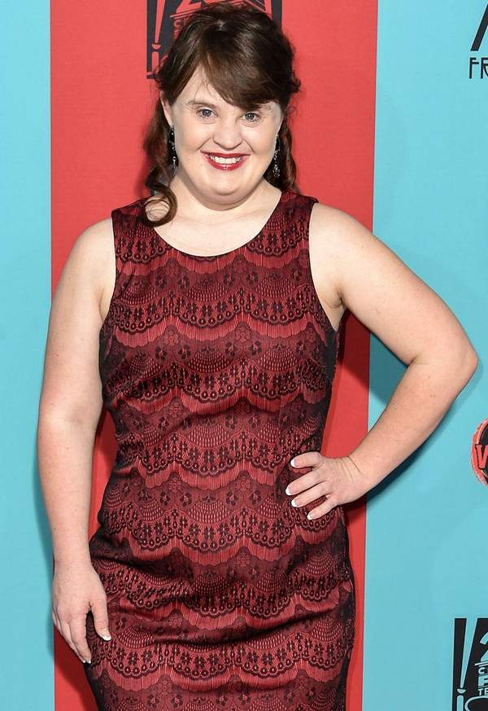
Fashion World - Jamie Brewer
Isabella is not the only women with Down syndrome to light up the fashion world. In 2015, actress Jamie Brewer became the first woman with this condition to model at New York Fashion Week
As if her achievements as actress and model aren't inspiring enough, she has also been instrumental in persuading Texas lawmakers to abolish the word "retarded" from state law. She continues to advocate for the rights of people living with intellectual disabilities.
Fashion World
Swimmer
Actor
Politician

Slide 6
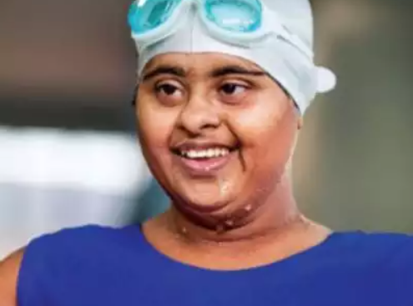
Swimmer - Arti Krishnamurthy
She is first and foremost an athlete, then a person with Down syndrome.
At 28 years of age, Arti is a star in the world of para swimming, with bronze and silver medals at the 2013 Special Olympics to her credit. She won her first gold medal in 1998 at the Special Olympics in Chandigarh.
Swimmer
Fashion World
Actor
Politician

Slide 7
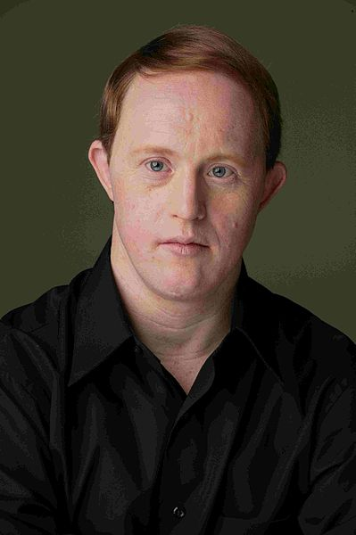
Actor and Singer - Christopher Joseph
Christopher Joseph “Chris” Burke is a former American actor and folk singer. He is currently an advocate for creating awareness about Down syndrome. As an actor, he became popular for the character Charles Thatcher in the TV series ‘Life Goes On’.
Chris Burke’s first work as a professional actor was in 1987, in the TV movie ‘Desperate’. His performance as the character Charles Thatcher was much appreciated.
Actor
Fashion World
Swimmer
Politician

Slide 8
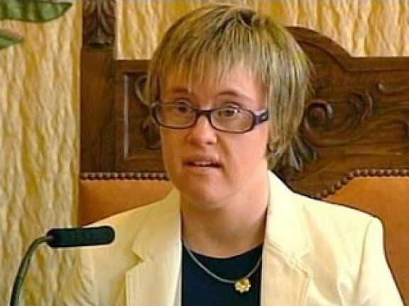
Politician - Angela Bachiller
Councilor Bachiller was the first person with Down syndrome to be elected to public office in Spain. After working as an administrative assistant at Valladolid City Hall, Ángela decided she wanted to represent the people of Spain. She was elected as Spain’s first City Councilor with Down syndrome in 2013
Politician
Fashion World
Swimmer
Actor

Slide 9
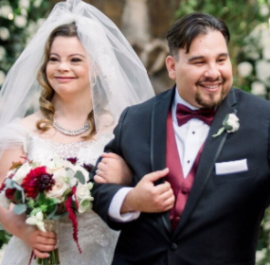
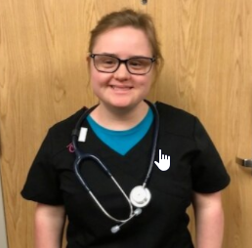
CHELSEA WERNER Chelsea Werner is a two-time world champion gymnast, and 4-time US champion gymnast, in the Special Olympics. She is also a model and has been featured at NYFW and in advertisements for Target and Aerie.
ANGEL & CRISTINA CALLAHAN Angel and Cristina are a married couple who happen to be co-stars on the reality show Born This Way. The couple let the show follow their wedding to show people a wedding between two people with disabilities.
ERIN HAWLEY Erin is taking nursing courses at Kent State University, working as a nursing assistant while she finishes her degree. Erin hopes to work full time as a CNA/PCA.
So this never-ending list goes on and on, I just need a slight trigger to set on.
There is nothing in the world which is not for me, I can do everything better than thee.

Slide 10
SAVE DOWN SYNDROME
If we are treated the same as people without any disabilities are treated by our societies, families, education systems, medical care providers, and governments, we can graduate from high school, graduate from college, find careers, start businesses, get married, have children, and more.

Slide 11
Thank You

